Slide 1
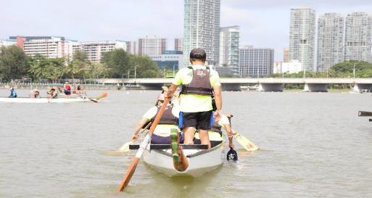
THE COACH OR COACH-CUM-STEER (updated on 25 Aug 2023)
The Coach or Coach-cum-Steer (“The Coach”) are advised to have the Recreational Instructor/Trainer (minimum) or Dragon Boat Technical Coach Level 1 or 2 certificate
For DOP or coaching of trainee Steers, the Coach or Coach-cum-Steer (“The Coach”) are required to hold either the Recreational Instructor/Trainer (minimum) or Dragon Boat Technical Coach Level 1 or 2 certificate.
The Coach must have complete situational awareness at all times
The Coach cannot be paddling while he/she is coaching a trainee Steer.
When coaching a trainee Steer, the Coach has to be at
the bow or at the rear. The Coach has to exercise his/
her judgement on the confidence of the trainee Steer
to decide whether to be at the bow or rear.
6) The Coach must always maintain awareness of the
Lightning Warning System (LWS) beacons.
7) The Coach is required to bring their smart phones
along to monitor the weather conditions on the
MyENV app.
Listen to me leh…
Please laa

